Slide 1
Unraveling Pancho Villa & The Mexican Revolution
by
Robert E. Call
for
Anson Bowen Call Family Organization

Slide 2
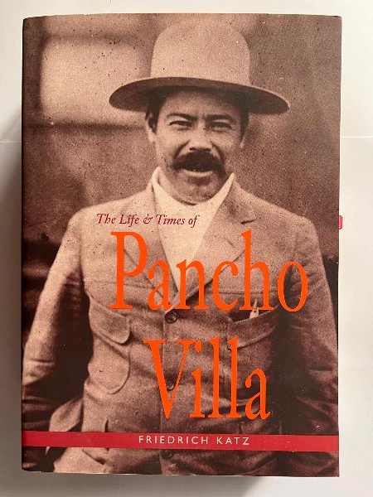
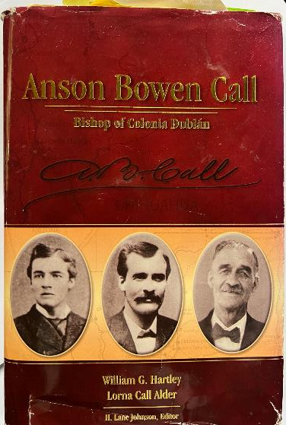
Reference Books

Slide 3
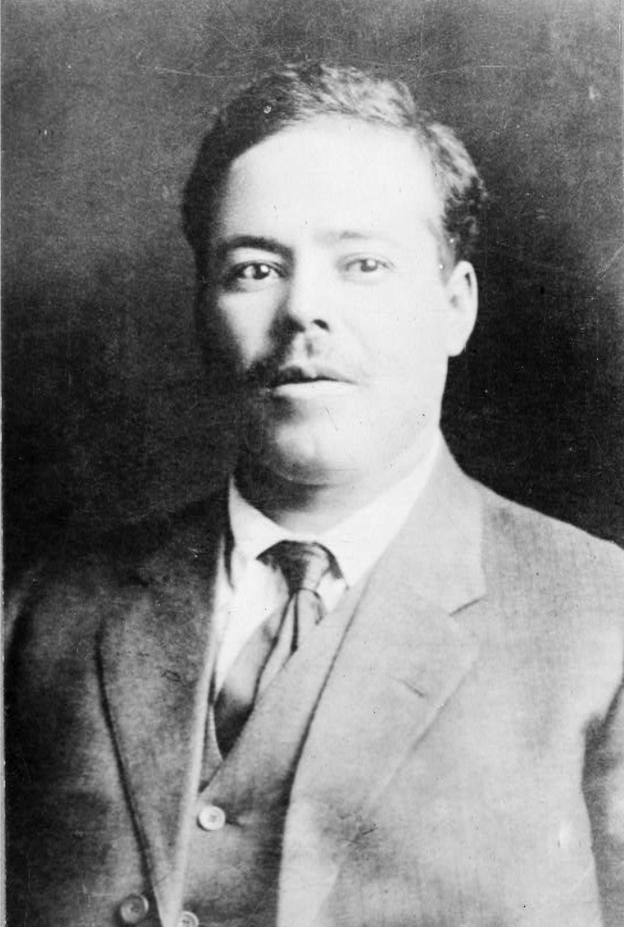
Pancho Villa Biography
Name: José Doroteo Arango Arámbula
Born: June 5, 1878, Hacienda de Rio Grande, San Juan del Rio, Durango
Parents: Agustín Arango (Villa) (debated) & Micaela Arámbula
Early life: Rancho de la Coyotada, San Juan del Rio, Durango
Known Siblings: Marina, Mariana, Martina, Antonio
Nickname- “La Cucaracha”
Pancho Villa 1910

Slide 4
Teenage Years
Left school upon his father’s death to support his mother and siblings.
Moved to Chihuahua to find work.
Work: sharecropper, muleskinner, butcher, brick mason, foreman for a U.S. railroad.
Returned to track down and kill the hacienda owner Agustín López Negrete, who had violated his sister.
September 22, 1894 he shot Negrete in the foot.
Fled to the mountains and later joined a band of thieves and adopted the name Pancho Villa.
In 1898 he was arrested and jailed for gun and mule theft.

Slide 5
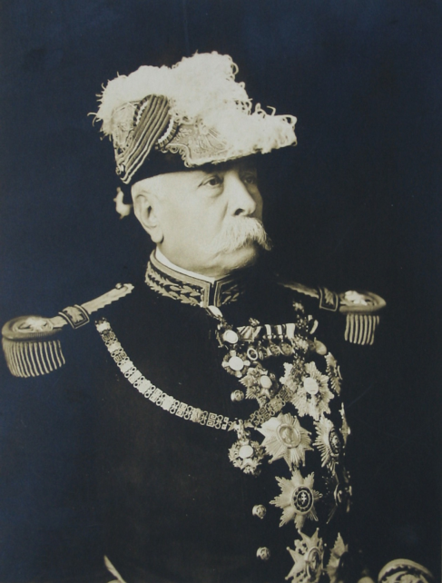
Mexican Politics
José de la Cruz Porfirio Díaz Born: Oaxaca, September 1830.
Military hero in the Reform War 1857-61, and the Battle of Puebla against the French in 1862.
President/Dictator- 1876-1911.
Modernized Mexico- railroads, telegraph, mining, oil, manufacturing, foreign investment.
Suppressed social equality, labor, land expropriation.
Forced to resign, exiled in Paris, died 1915.
Porfirio Díaz

Slide 6
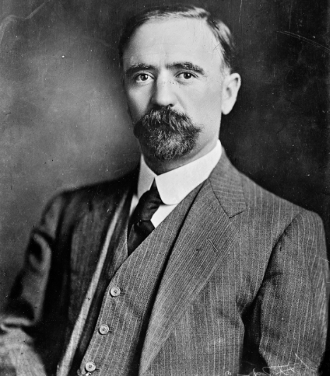
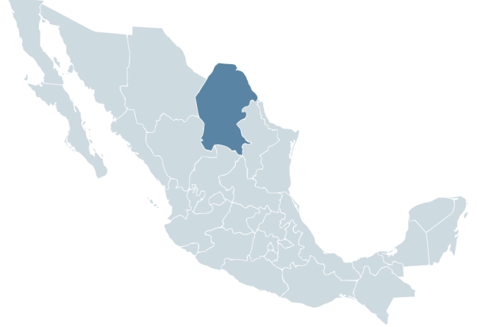
Mexican Politics
Francisco Ignacio Madero González
Born: October 30, 1873, Parras de la Fuerte, Coahuila, to a wealthy family.
Educated in France & UC- Berkeley.
Arrested after “losing” the 1910 fraudulent election. Escaped from jail and fled to the United States.
His Plan of San Luis Potosi called for the overthrow of President Porfirio Díaz, sparking the Mexican Revolution.
Returned and marshaled rebels to overthrow Porfirio Díaz.
Elected President in a landslide (1911-13).
Francisco I. Madero
State of Coahuila

Slide 7
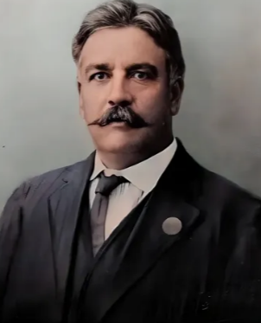
Mexican Politics
Abraham González de Hermosillo y Casavantes
Born: June 7, 1864, Basuchil, Chihuahua.
Educated at University of Notre Dame, South Bend, IN.
González’s family was opposed to the Creel/Terrazas monopoly in Chihuahua.
Madero recruits wealthy landowner, Chihuahua Governor Abraham González to the rebel cause.
González recruits Pancho Villa & Pascual Orozco as Revolution Leaders for Madero.
Madero forces lose the Battle of Casas Grandes, then win the Battle of Cuidad Juárez with Villa & Orozco.
Abraham González

Slide 8
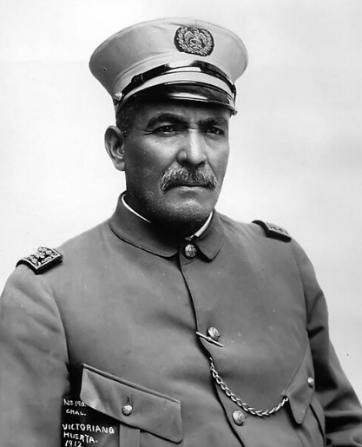
Mexican Politics
José Victoriano Huerta Márquez
Born: December 23, 1850, Colotlán, Jalisco.
Graduated in 1877 from Colegio Militar de Chapultepec, Mexico City, as an engineer and topographer.
Retired in 1907 because of poor health.
President Madero ask him to come out of retirement to replace generals who were killed or wounded.
Involved in coup d'état with Porfirio Díaz's nephew, General Félix Díaz, U.S. Ambassador Henry Lane Wilson, Pascual Orozco and others against President Madero.
Victoriano Huerta

Slide 9
Mexican Politics
Madero & Pino Suarez arrested and murdered by officials of the Victoriano Huerta regime in March 1913.
Mexican President 1913-14.
Arrested & murdered Abraham González.
Forced to resign after military victories by Villa and Orozco.
Germany initiated a plan for Huerta to regain the Mexican presidency through a coup d'état, but was foiled.
Arrested by U.S. for sedition and imprisoned at Fort Bliss, TX.
Died while in prison probably from cirrhosis of the liver or cancer.
Victoriano Huerta

Slide 10
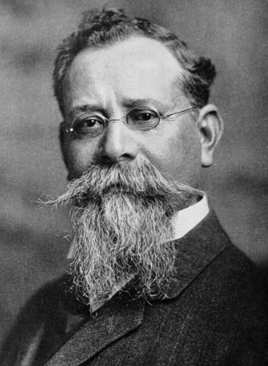
Mexican Politics
Venustiano Carranza de la Garza
Born: December 29, 1859, Cuatro Ciénegas, Coahuila, from a wealthy land owning family after ouster of the French.
Senator, then Governor of Coahuila, appointed by Madero.
His Constitutional Army defeated Huerta's Federal Army with Generals Villa & Álvaro Obregón.
Drew up the Plan of Guadalupe to oust President Huerta.
Leader in drafting the 1917 Constitution.
President of Mexico 1914-20.
Venustiano Carranza

Slide 11
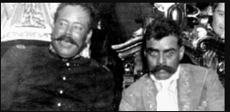
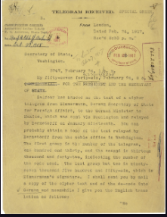
Mexican Revolution 1910-1920
General Álvaro Obregón remained loyal to Carranza. President of Mexico 1920-24.
Villa broke with Carranza, September 1914, aligning with southern peasant leader Emiliano Zapata.
In 1915, U.S. President Woodrow Wilson formally recognized President Carranza to help stabilize Mexico, but alienated Pancho Villa.
Germany proposed an alliance with Mexico-Zimmerman Telegram. Carranza declined, maintaining neutrality during World War I.
Villa’s troops arrive in Dublán, Chihuahua for a 22 days in late September 1915.
Villa’s troops leave for Agua Prieta, Sonora.
Pancho Villa & Emiliano Zapata
Zimerman Telegram intercepted by the British

Slide 12
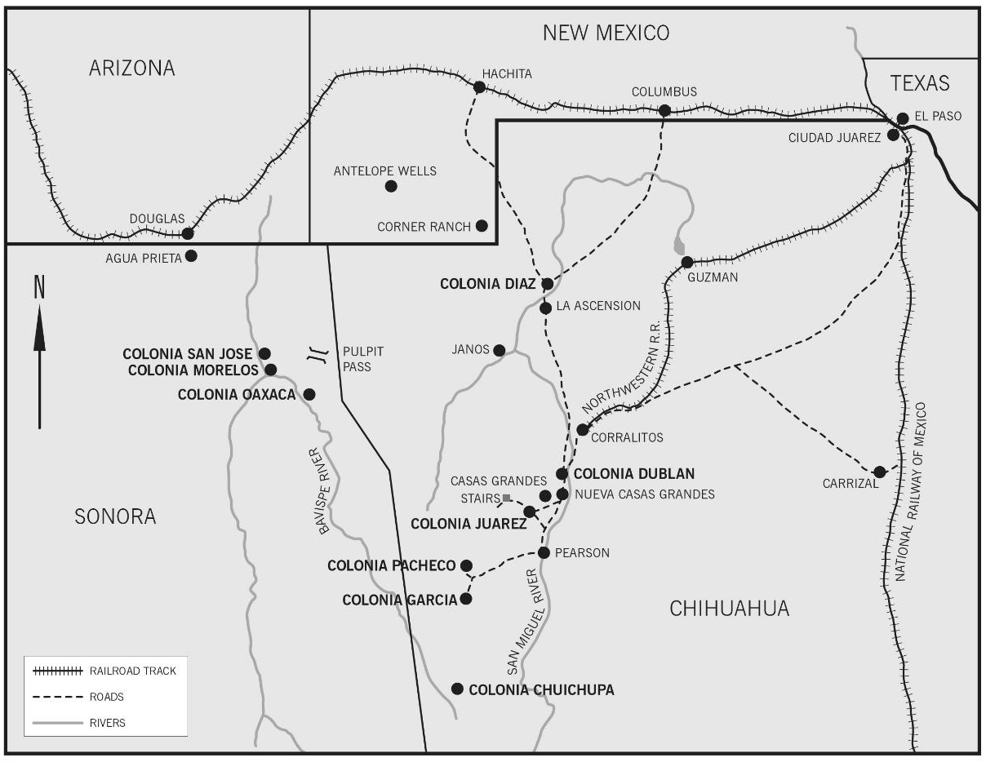
Mexican Revolution 1910-1920
U.S. railroads transported reinforcement troops for Carranza to Agua Prieta, Sonora from El Paso, TX.
U.S. supplied machine guns, land mines, spot lights powered by electricity from Douglas, AZ.
Villa was defeated at Agua Prieta by General Plutarco Calles’ troops on November 5, 1915. Villa loses again 10 days later in Hermosillo, Sonora.
Villa’s Division del Norte
never recovers from these battles.
Villa vows to kill Americans in
Mexico, killing ranchers and 17
U.S. Cusi Mining Co. employees
Jan. 10, 1916.
Villa retaliates by attacking the
U.S. Army 13th Cavalry, Columbus,
NM, killing 8 soldiers and 10
civilians on March 9, 1916.
Villa loses 100 men.

Slide 13
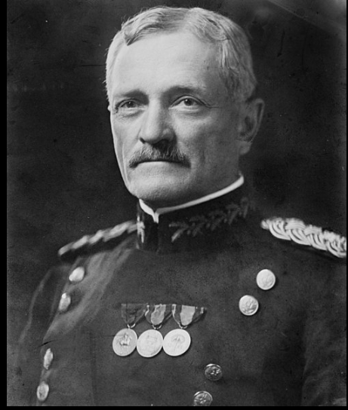
Mexican Revolution 1910-1920
Dublán “Passover” miracle, March 13, 1916, when Villa and his forces passed by.
Pershing organized and commanded the Mexican Punitive Expedition, from Ft. Bliss, entering Mexico on March 16, 1916.
A combined armed force of 10,000 men penetrated 350 miles into Mexico.
First Calvary to use motor truck tracked vehicles and bi-planes for reconnaissance.
Failed to capture Pancho Villa.
Leaves Mexico in February 1917.
Prepared Army for World War I. U.S. enters War on April 1917. Future military leaders- George Patton, others.
General John J. Pershing

Slide 14
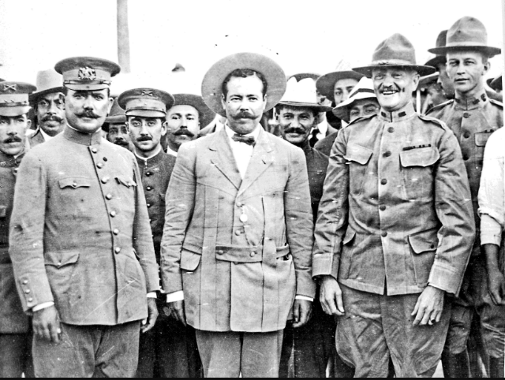
Mexican Revolution 1910-1920
General Álvaro Obregón , Pancho Villa, General John Pershing,
August 1914, Fort Bliss, TX.

Slide 15
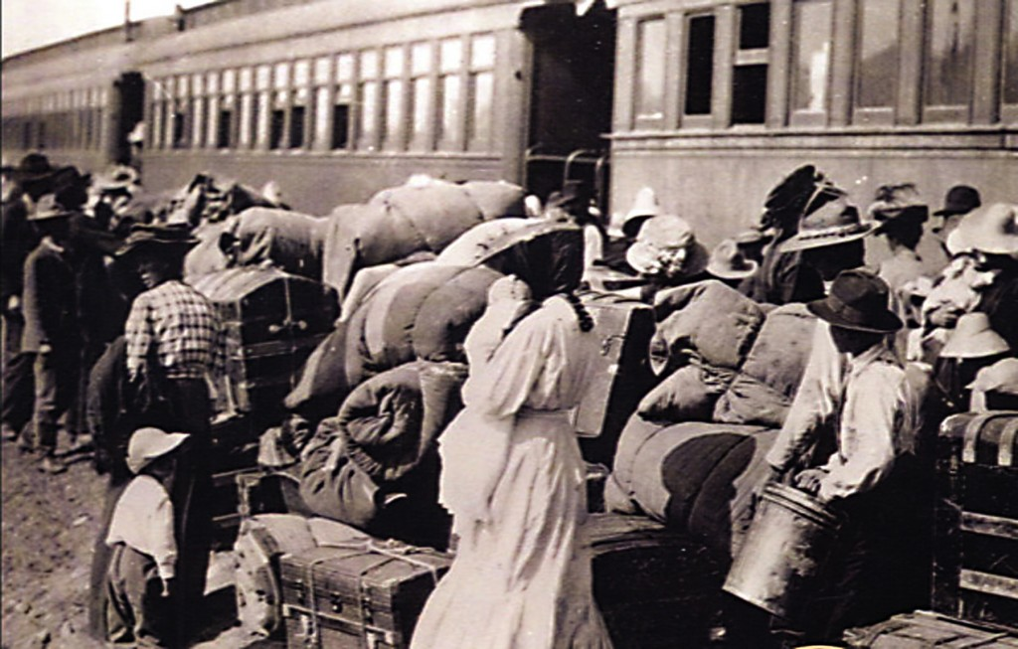
Mexican Revolution & Call Family
Bowen and his family lived in Mexico for 22 years before leaving.
First Exodus- Families boarded U.S. provided train to El Paso, TX, July 27, 1912. Bowen followed on August 13. Returned July 1913.
Second Exodus- April 24, 1914. Returned November 1914.
By September 1915 only 10% of Colonists had returned to Mexico.
Third Exodus- January 29, 1917, with U.S. Army. Returned June 1917.
Baggage ready to be loaded onto refugee train.

Slide 16
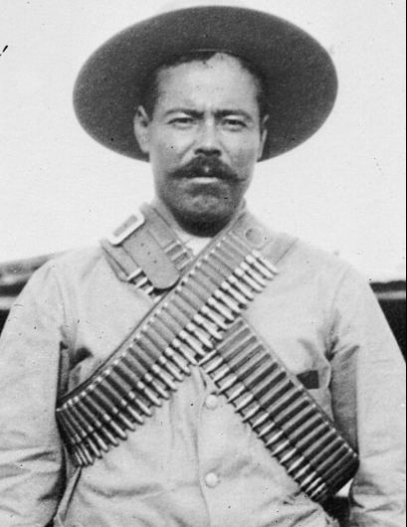
Pancho Villa Retirement
In 1920, President Venustiano Carranza was ousted by Álvaro Obregón & fled. Assassinated/suicide?
Villa was given Canutillo Hacienda, 25,000 acres and 50 security men in the State of Durango.
Also, a generous pension and land for his men.
On July 20, 1923, while driving his car through Parral, Chihuahua, he was ambushed and killed, receiving 11 bullets.
Our family visited his widow Maria Luz Coral de Villa in Chihuahua City in 1966.
In 1973 his remains were moved to the Monument of the Revolution, Mexico City.
Polarizing individual- Folk hero? Bandit? Robin hood? Revolution hero? Killer?
Pancho Villa

Slide 17
Mexican Revolution Results
1 to 2 million deaths.
Ended 35 year dictatorship of Porfirio Diaz.
Progressive 1917 National Constitution was adopted, similar to the U.S.A. Still in force today.
Separation of church & state. Religious freedom.
One six-year term limit for the President.
Agrarian reform by redistributing large haciendas and land. Establishment of the communal ejido system.
Removed economic grip of foreign investors.

Slide 18
Mexican Revolution Results
Universal male suffrage. Women suffrage in 1953.
Freedom of speech, press, & assemble. Due process.
Workers rights for an 8 hour work day & to organize and strike.
Free universal, secular and compulsory education.
Economic Nationalism- state ownership of national resources- forests, fisheries, minerals & petroleum.
Intended to form a democracy, but one party rule (PRI), established for 71 years until 2000.
Currently President Claudia Sheinbaum Prado (PRD), Ph.D.- Energy Engineering- UNAM, Jewish heritage.

Slide 19

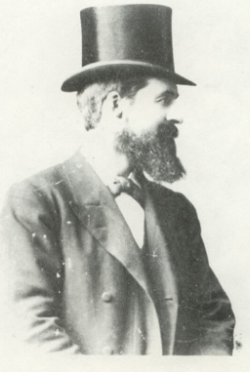
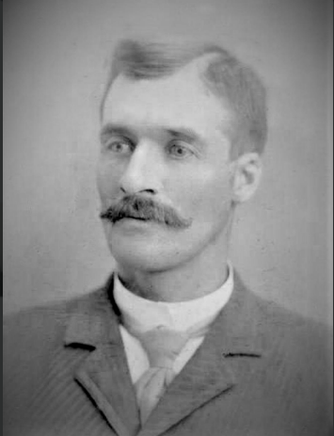
QUESTIONS?
Anson Bowen Call

